Slide 1
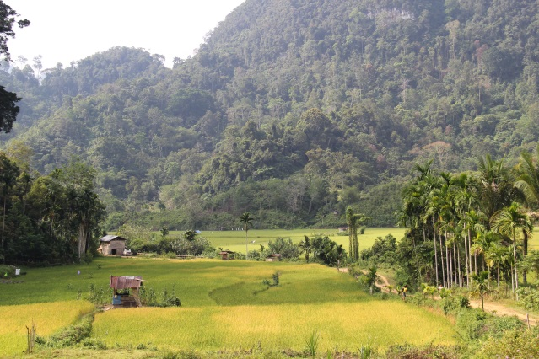
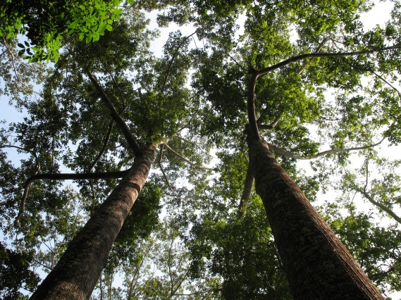
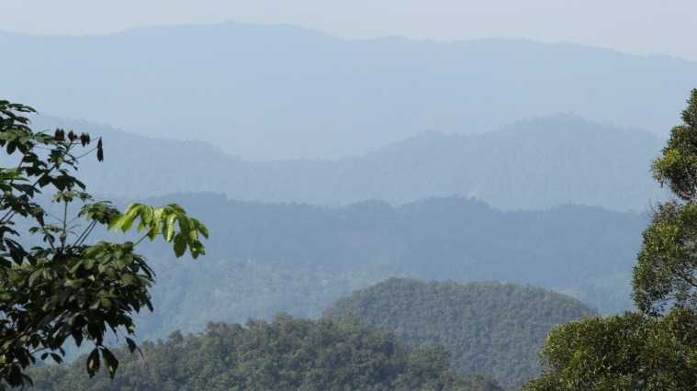
Development of Safeguards Information System (SIS) for REDD+ : Indonesia’s experience
Novia Widyaningtyas
Head of REDD+ Division – Directorate General of Climate Change
Ministry of Environment and Forestry – Republic of Indonesia
Rio Convention Pavilion – COP21
Paris – France, 7 December 2015

Slide 2
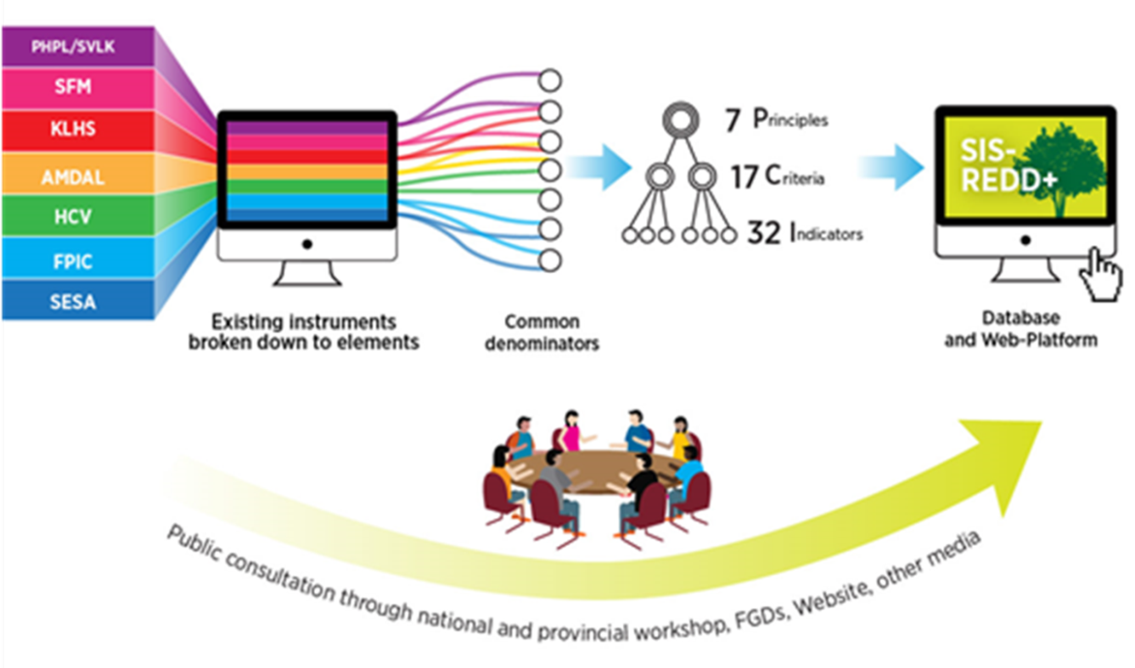
The process of designing the SIS
Two tracks process :
Multi stakeholders communication (to develop institutional structure and discuss how the system works (2011-2012); to develop tools to assess conformity of safeguards implementation with PCI (2013)
Consultant work (identify and assess/analyze existing RPIs to develop PCI for SIS-REDD+ Indonesia, establishment of institutional structure in SIS-REDD+; develop database system and web based SIS)
+ assessment tools
Notes:
Design : Simplicity, Completeness, Accessibility, Accountability
Provision of Information : Structure, Mechanism, Institutions, Elements of safeguards (7 safeguards), PCI & tool to assess safeguards implementation, Platform

Slide 3
Institutional structure and information flow in SIS-REDD+

Slide 4
Achievements and on-going improvement
7 Principles, 17 Criteria, and 32 Indicators for SIS-REDD+ in Indonesia, along with a set of Assessment Tools for respective indicators – have been developed
Institutional arrangement and information flow for SIS-REDD+ have been developed
A web-based SIS-REDD+ in Indonesia has been developed, and ready for operationalization after tested at national and provincial level (Jambi Province and East Kalimantan Province)
The case of East Kalimantan : development of Provincial Safeguards, coordination and synergy among existing REDD+ Safeguards initiatives (SIS, PRISAI, REDD+ SES); intensively multi-stakeholder process are applied and on going; REDD+ SES was consulted in 3 districts (Berau, Paser, and Kutai Kertanegara); assessments were conducted and the results are inputs for SIS at National level (in progress). In addition, PRISAI are also tested in some province/districts
With the merging of REDD+ Agency – MoEF, integration of PRISAI into SIS-REDD+ will be started soon , along with the improvement of the web platform
Indonesian Summary of Information on how REDD+ safeguards are addressed and respected – are being prepared to be submitted through National Communication

Slide 5
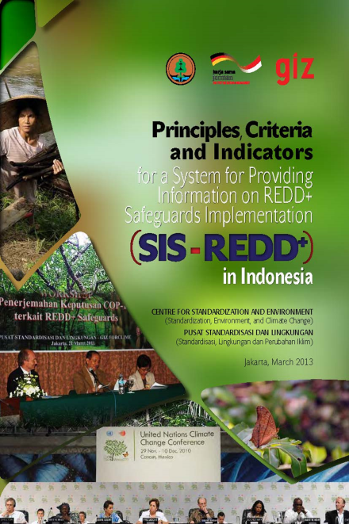
Safeguard → PCI → Asessment Tools
7 Principles, 17 Criteria, 32 Indicators :
1 (3C – 4I)
2 (2C - 3I)
3 (4C – 6I)
4 (2C – 6I)
5 (2C – 6I)
6 (2C – 4I)
7 (2C – 3I)
Developed for assessing safeguards implementation (how the seven safeguards from COP-16 decision are addressed and respected),

Slide 6
SIS-REDD+ Indonesia : key milestones
SIS –REDD+ Concept Development
Database System dan Web Platform start
PCI SIS REDD+ published
FGD & trial SIS REDD+ at provincial level 2
July 2014
Feb 2015
May 2014
FGD ,trial SIS REDD+ and develop web platform in Kaltim
December 2013
FGD & trial SIS REDD+ at provincial level
May2013
COP 19 : SIS as the basis for resul based payment
July 2013
Public Consultation and Trial PCI
November 2012
March 2012
December 2011
FGD : PCI SIS REDD+ development
February
2011
COP 17 :Principles for SIS
Desember
2010
COP 16: Cancun Safeguards

Slide 7
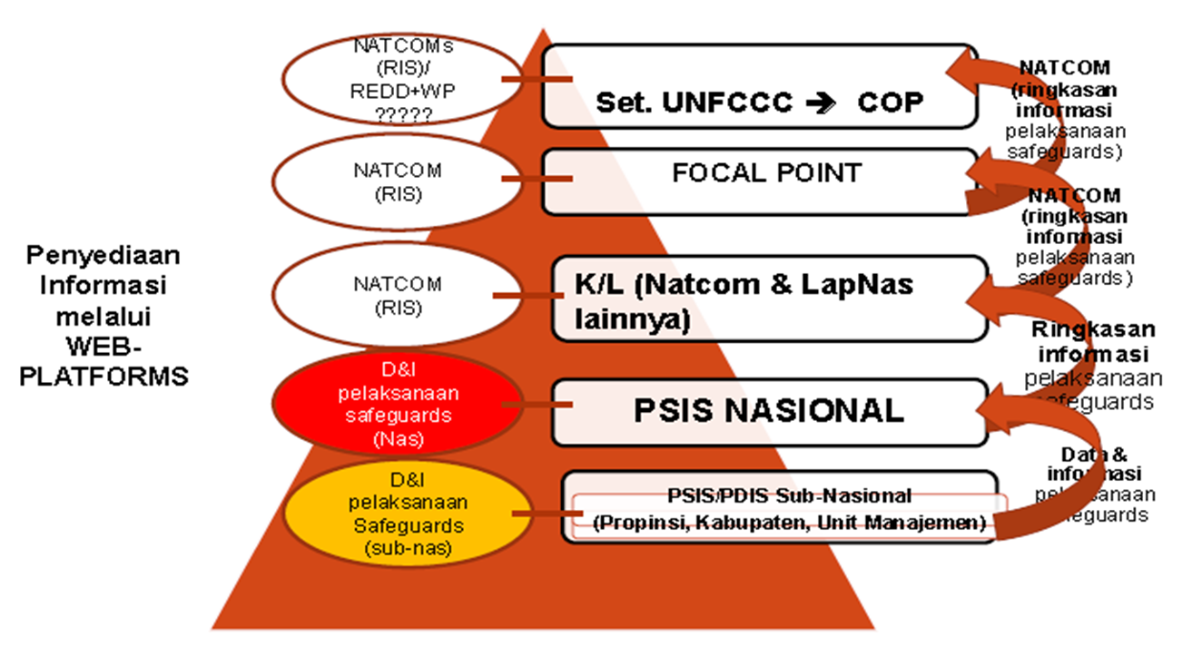
Institutional structure & mechanism SIS-REDD+
Flow of information within the institutional structure

Slide 8
Lessons learned and opportunities :
Lessons learned :
It is important to use phased approach in applying CSA
Need to define what are the objectives / scope (country specific)
Analyzing the existing policy instruments, principles and best practices, are invaluable assets for translating safeguards into national context – effective and efficient
The importance of iterative process, in identifying REDD+ safeguards key elements through assessment of the strength and weaknesses of each of all existing safeguards related instruments
Throughout the process, multi-stakeholder participation (central government, local government, academia, NGOs) is essential; need to from the beginning of the process
Opportunities :
SIS-REDD+ : beyond providing information; SIS will be a useful tool to enable REDD+ as a vehicle towards improvement of forest governance
SIS-REDD+ : could bridge safeguards interest at the int’l level with local/national level by internalizing global guidance in existing systems and mechanisms in Indonesia
SIS-REDD+ : provides opportunity for alignment between country safeguards approach/framework with safeguards framework developed by global institution and donors -- build synergy for REDD+ implementation

Slide 9
Results compared to expectations :
Institutional aspect in operationalizing the SIS :
At national level : organizational change is a challenge; limited human resources
Self/voluntary assessment in providing information
plus-minus, need high commitment , how to make information available
At sub national level : the existence of a formal institution (in charge of information system) is not a guarantee; capacity and political commitment improvement is needed.
Maintaining operationalization of the system
Need synergy with other REDD+ safeguards-related system

Slide 10
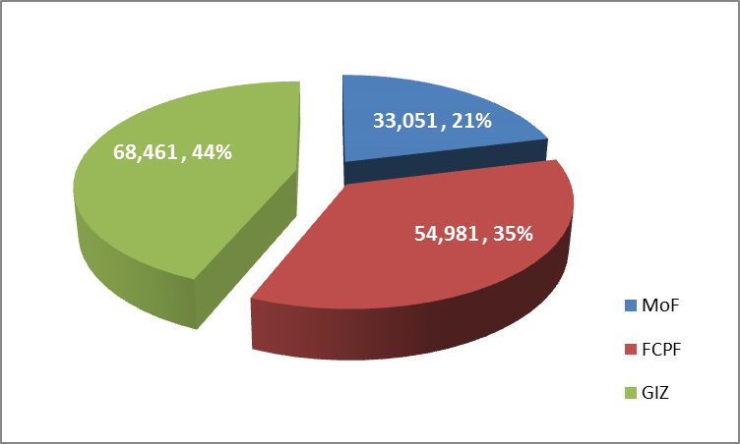
Initial investment for national SIS-REDD+ development and subnational trial in 2 Provinces in Indonesia 2011-2014 (approx., in USD)
Resources :
Multi-stakeholders : central government, local government, national NGO, local NGO, universities, REDD+ WG)
Global partners : GIZ-Forclime, FCPF, REDD+ SES
Experties, tools, MoEF Team

Slide 11
Next steps :
Keeping the system operational (i.e. in managing data-base and web-platform)
Creating legal umbrella for full operationalization of the SIS-REDD+, in accordance with recent organizational arrangement
Improvement of capacity and commitment of responsible institutions at the sub-national levels, to link the national system into sub-national level (province and district)
Integrating results of parallel processes relating to safeguards and SIS-REDD+ development, especially in adjustment with recent organizational structure
Getting local community more involved in the SIS operationalization : awareness raising, capacity building (FFI – Jambi & Ketapang, Central Sulawesi (Ngatatoro Community) and Central Kalimantan (Tumbang Bahanai Community)

Slide 12
THANK YOU
noviawidyaningtyas@yahoo.com
widyaningtyasnovia@gmail.com

